Slide 1

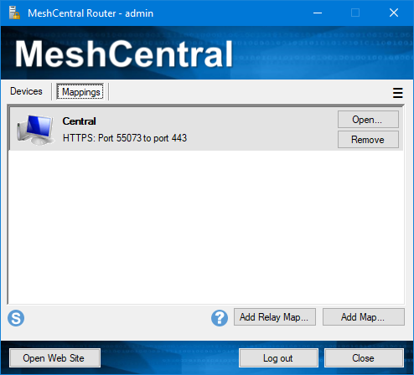

MeshCentral
Browser
Agent
Web Server

Slide 2
MeshCentral
Browser
Agent
Web Server

Slide 3
MeshCentral
Redirection Port 80
Main Port 443
Relay Port 453
Off by default
{
"settings": {
"port": 443,
"redirport": 80,
"RelayPort": 453
}
}

Slide 4

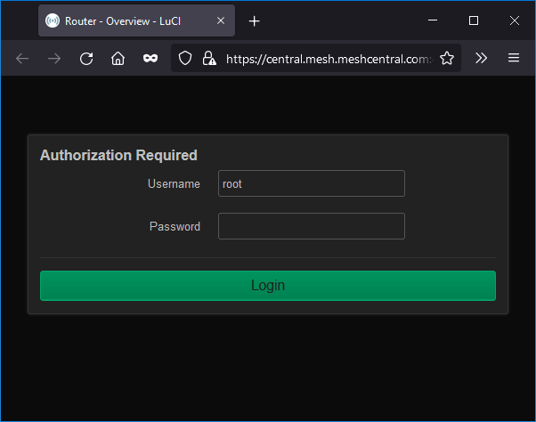
NodeID
Address
Port
TLS or not
MeshCentral
Relay Port 453
HTTPS
Web Server

Slide 5
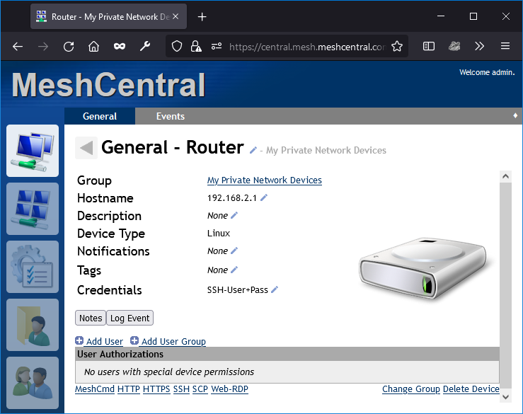
{
"settings": {
"port": 443,
"RelayPort": 453
}
}

